Slide 1
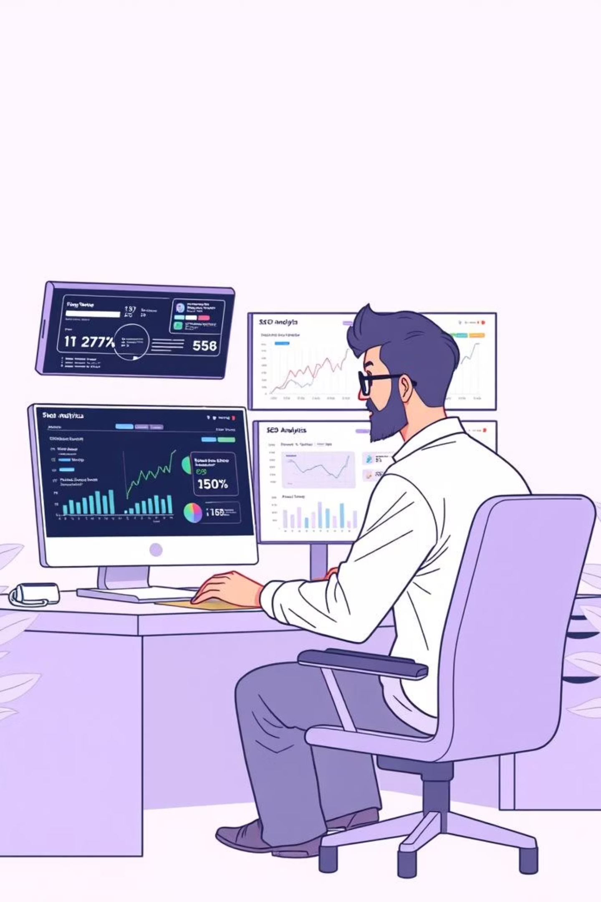
SEO Navigator: From Audit to Action
Presented BY Abubakkar Siddiq MBA

Slide 2
SEO Navigator: From Audit to Action
A comprehensive SEO audit and action plan for Deskera.com, focusing on improving visibility and performance for this established SaaS provider of enterprise application software.
Deskera – Company Snapshot
Founded: 2008 | HQ: Singapore
Industry: SaaS – Enterprise Application Software
Target Market: SMEs (Global, Asia focus)
Solutions Offered:
ERP – Accounting, HR, Finance
MRP – Manufacturing, Inventory, Supply Chain
CRM – Sales, Marketing, Customer Engagement

Slide 3
Executive Summary
57/100
17+
0
0
SEO Health Score
Domain Age (Years)
Indexed Pages
Backlinks
Strengths
Weaknesses
SEO-friendly URLs
0 indexed pages
Domain age (17+ years)
0 backlinks
GZIP compression
No mobile optimization
Opportunities
Threats
Authority building in ERP & MRP space
Competitors like Zoho & TallyPrime already strong in search
SME-targeted keywords

Slide 4


SEO Audit Report
Technical SEO
Site structure, load speed, mobile performance
On-Page SEO
Titles, meta descriptions, headings, ALT tags
3
Off-Page SEO
Backlinks, domain authority, referral traffic
4
User Experience
Navigation, usability, page hierarchy

Slide 5





Key Audit Findings
Critical Issues
0 indexed pages
113 images missing ALT tags
No Google Analytics
Invisible to Google
No performance tracking
Accessibility & SEO loss
Mobile-friendliness score: 0/100
Page load: 3.43s
Site is not optimized for mobile devices at all
Above ideal load time of <2s

Slide 6
SWOT Analysis
Weaknesses
Strengths
❌ No indexing → zero organic visibility
✔ Domain age 17+ years
✔ Clean SEO-friendly URLs
❌ Lack of mobile-first design
✔ Strong SaaS brand positioning
❌ Thin metadata, weak internal linking
Opportunities
⭐ Growing SME SaaS market in ERP/MRP
Threats
⚠ Competitors (Zoho, Tally, SAP) already ranking
⭐ Content gaps in affordable ERP/MRP space
⚠ Algorithm changes penalizing slow sites
⭐ Backlink building from SaaS, SME, and finance sites

Slide 7
Priority Recommendations
Submit site for indexing in Google & Bing
First critical step to become visible in search engines
Fix metadata (titles, descriptions, H1s)
Optimize all page elements for search visibility
Improve mobile responsiveness & UX
Create mobile-friendly experience for all users
Install Google Analytics + Search Console
Enable performance tracking and monitoring
Optimize speed → minify JS/CSS, compress images
Improve page load times for better user experience
Begin backlink outreach campaign
Build authority through quality backlinks

Slide 8




Keyword Research: ERP
Informational
Navigational
"What is ERP software"
"SAP ERP"
"ERP benefits for SMEs"
"Oracle NetSuite ERP"
Transactional
Commercial
"Buy ERP software online"
"Best ERP for SMEs"
"ERP demo for small business"
"ERP implementation cost"

Slide 9




Keyword Research: MRP
Informational
Navigational
"What is MRP system"
"Katana MRP"
"How does MRP work in manufacturing"
"MRPeasy software"
Transactional
Commercial
"Buy MRP solution"
"Affordable MRP software for SMEs"
"Cloud-based MRP system"

Slide 10



Search Intent Mapping
TOFU (Awareness)
1
Informational keywords → Blogs, Guides
MOFU (Consideration)
2
Comparison keywords → Case Studies, Webinars
BOFU (Decision)
3
Transactional keywords → Landing Pages, Demos
This marketing funnel approach aligns content types with user search intent at different stages of the buyer's journey, ensuring Deskera delivers the right content at the right time.

Slide 11



Competitor Keyword Insights
Current Competitor Strengths
Zoho: Strong in "Cloud ERP," automation-related keywords
Identify Competitor Gaps
Find keywords competitors aren't targeting effectively
TallyPrime: Dominant for "Offline ERP," "Accounting ERP"
Create Targeted Content
Develop high-quality content for gap keywords
Gap Opportunities for Deskera
Optimize & Promote
Build authority in these niche areas
"Affordable ERP/MRP for SMEs"
"Mobile-first ERP software"
"ERP vs MRP explained"

Slide 12
On-Page SEO Audit – ERP Page (deskera.com/in/erp)
Findings & Recommendations
Title Tag
Meta Description
Headings & Content
Good keyword use; move Deskera ERP to front + add India for local targeting.
Missing/generic → add keyword-rich (~150–160 chars). Ex: "Deskera ERP India: Cloud ERP for accounting, inventory, HR, CRM & BI."
H1 "Business. Simplified." → update to "Deskera ERP – Business. Simplified."
Links
Images
Internal linking strong; improve anchor text + add credible external references.
Alt text & filenames unclear → optimize with descriptive, keyword-rich labels.

Slide 13
On-Page SEO Audit – MRP Page (deskera.com/in/mrp)
Findings & Recommendations
1
Title Tag
1
Links
Ensure Deskera MRP upfront; add India for regional SEO.
Internal links good; make anchor texts keyword-specific; add external industry references.
2
Meta Description
2
Images
Absent/generic → craft engaging summary with focus keywords. Ex: "Deskera MRP India – Manage materials, production & demand forecasting in one cloud solution."
Missing ALT/descriptive names → optimize filenames + ALT text for features/screens.
3
Headings & Content
H1 "Manufacturing. Simplified." → update to "Deskera MRP – Manufacturing. Simplified."

Slide 14
On-Page SEO Best Practices
1
Use 1 H1 per page with main keyword
Ensure each page has exactly one H1 tag that contains the primary keyword for that page.
2
Add compelling meta descriptions (150–160 chars)
Create unique, action-oriented meta descriptions that include relevant keywords.
3
Include schema markup (FAQ, How-To, Review)
Implement structured data to enhance search results with rich snippets.
4
Optimize anchor texts for internal linking
Use descriptive, keyword-rich anchor text for internal links between related pages.
5
Maintain keyword density 1–2%
Keep keyword usage natural while maintaining optimal density for search engines.

Slide 15
Technical SEO Analysis
Technical Issues
Mobile SEO Issues
Page load: 3.43s → needs <2s
Mobile-friendliness: 0/100
HTML/text ratio: 2.4% → too much code, not enough content
No responsive design → poor UX
Mobile indexing risk → site won't rank well
0 mobile responsiveness
No canonical tags → duplicate risk
Fix: Mobile-first redesign, responsive layout, lazy loading
No HTTPS performance tuning

Slide 16
Technical SEO Best Practices
Compress & optimize images (WebP/AVIF)
Minify JS/CSS → reduce file size
Reduce image file sizes while maintaining quality to improve page load times.
Remove unnecessary characters and whitespace from code to decrease load times.
Use CDN for global delivery
Add SSL, canonical tags
Implement a content delivery network to serve assets from locations closer to users.
Secure the site and prevent duplicate content issues with proper implementation.
Improve TTFB (target <200ms)
Implement structured data (JSON-LD)
Optimize server response time for faster initial page loading.
Add schema markup to help search engines understand page content better.

Slide 17




Content Strategy
Content Objectives
Authority Building
Establish Deskera as ERP/MRP authority for SMEs
Buyer Journey
Address full buyer journey (Awareness → Decision)
Content Types
Leverage blogs, case studies, videos, FAQs
Longevity
Focus on evergreen content for long-term ranking

Slide 18
Content Plans for ERP & MRP
ERP Content Plan
MRP Content Plan
Informational: "What is ERP? Beginner's Guide for SMEs"
Informational: "How MRP Helps Manufacturing SMEs"
Navigational: "SAP vs Oracle vs Deskera – ERP Comparison"
Navigational: "Katana vs Deskera MRP"
Transactional: "Cloud MRP – Start Free Trial"
Transactional: "Get a Free ERP Demo for SMEs"
Evergreen: "Types of MRP Explained"
Evergreen: "Top 10 ERP Features Every Business Needs"

Slide 19
6-Month SEO Roadmap
1
Month 1–2
Fix indexing, metadata, speed optimization, analytics setup
2
Month 2–3
Publish ERP & MRP keyword-driven content, optimize landing pages
3
Month 3–4
Outreach for backlinks, directory submissions
4
Month 4–6
Scale blog publishing, integrate social media, build PR mentions

Slide 20
KPIs & Final Recommendations
KPIs & Success Metrics
200+
<2s
Indexed Pages
Page Speed
From 0 to 200+ pages indexed
From 3.43s to under 2 seconds
85+
50+
Mobile Score
Quality Backlinks
From 0/100 to 85+
From 0 to 50+ quality links
+50%
Organic Traffic
50% growth in 6 months

Slide 21
Final Recommendations
Technical Fixes
Fix critical technical issues immediately (indexing, mobile, speed)
Content Development
Build ERP/MRP content hub to capture keywords & intent
Authority Building
Strengthen authority via backlinks & PR
Ongoing Optimization
Implement continuous SEO monitoring
Long-term Vision
Long-term → establish Deskera as #1 ERP/MRP SaaS for SMEs

